Slide 1
BM329 workshop D
Dr. Morgan Feeney, Prof. Paul Hoskisson, Dr. Leighton Pritchard

Slide 2
Learning Objectives
After this workshop, students will be able to:
Describe influenza virus particles and how they replicate
Explain the role that antigenic shift and antigenic drift play in influenza virus evolution
Discuss the effects of vaccination and antiviral drugs on influenza virus evolution and public health
Build phylogenetic trees representing the evolution of influenza viruses

Slide 3
Influenza virus causes seasonal and pandemic flu
Negative-strand RNA virus; orthomyxovirus
Virion has helical symmetry, but in reality amorphous appearance
Segmented genome
8 separate RNAs, 890-2341 nucleotides
Influenza A, B & C
Influenza A is key cause of ‘flu [seasonal ‘flu kills avg. 400k/year; pandemic ‘flu can kill millions more]
Influenza A subtypes based on H and N proteins
Hemagglutinin (H1 – 18): Sialic acid binding protein (lectin), key determinant of host specificity
Neuraminidase (N1 – 11): Sialidase, key role in virus assembly
H1N1 and H3N2 are most common circulating subtypes that cause disease in humans

Slide 4
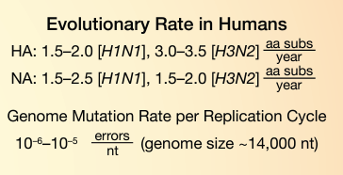
Influenza virus replication
Negative sense mRNA virus
RNA-dependent RNA polymerase – no proofreading
8 genome segments – must be packaged correctly to form an infectious virion

Slide 5
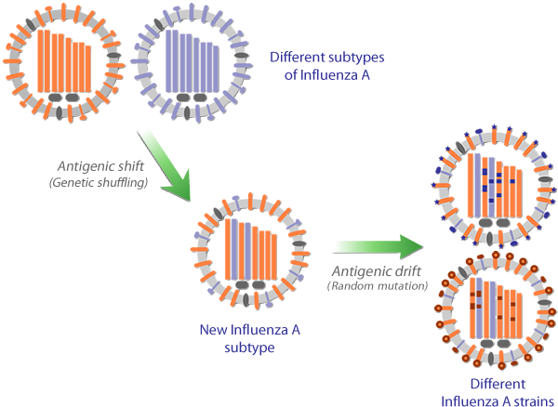
Virus evolution by antigenic shift and antigenic drift

Slide 6
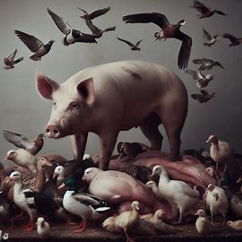
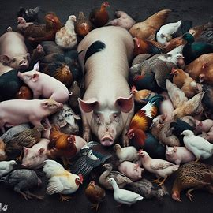
Swine and bird flu
Image credit: Microsoft Bing

Slide 7
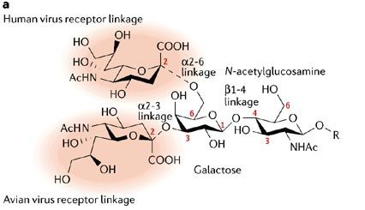
Hemagglutinin specificity and the “mixing bowl” theory
H1N1 (human) viruses: bind α-2,6 linked sialic acid
The major linkage in human respiratory epithelia
Some α-2,3 linked sialic acid is present
H5N1 (avian): bind α-2,3 linked
The major linkage in the e.g. duck gut
Pig trachea: both linkages present
Co-infection with H1N1 and H5N1 could occur in pigs or humans
Recombination with flu/swine flu
(“mixing bowl” theory) → generate new variants (potentially more deadly, pandemic strains)

Slide 8

Workshop overview – modelling influenza evolution
You will each be given a chance to assemble a ‘flu virus particle and we will monitor the spread of these viruses in the class
Envelope = virus capsid
Paper strips = virus genome segments
[need 8 for a correctly assembled, infective virus particle - PB1, PB2, PA, NP, HA, NA, M, and NS]
- each strip is labelled with the genome segment name and allele
-e.g., “PB1 – A” is segment PB1, allele A
We will model antigenic drift (random mutations) and antigenic shift (reassortment)

Slide 9
Workshop instructions
Work in pairs – everyone should find a partner. Each pair should join a larger group - more details next slide
Each round consists of 3 actions:
Acquire a new ‘flu virus [in the first round, do this by drawing randomly from the pool of available viruses; in subsequent rounds, do this by passing viruses clockwise in your group]
Determine the outcome of the virus infection [roll the die]
Replicate the virus (or not) depending on the outcome of the roll [Table 1 instructions].
You should play until you have six viral genotypes recorded in Table 2.
Make sure you record each genome (allele #s) in Table 2 in the handout!

Slide 10
Table 1. Dice rules for determining the outcome of a ‘flu virus infection.
Roll | Outcome
1 | Pre-existing immunity: virus does not infect/replicate [do not record in Table 2; return virus to the general pool]
2, 4, 5 | Infection: the virus is able to replicate. Record starting genome state in Table 2 & add a mutation to 1 segment randomly (+0.1 to the allele number) before passing it on
3 | Co-infection!: draw a new virus packet from the general pool → mix your two viruses and draw 1 of each segment at random → assemble new viral genome. Record genome in Table 2 & add a mutation to 1 segment randomly (+0.1 to the allele number) before passing it on
6 | Superspreader! virus infects and replicates in several hosts. [record genome 2x in Table 2 & add a mutation to 1 segment randomly (+0.1 to the allele number) before passing it on

Slide 11
Today’s research question: does population size have an effect on ‘flu virus evolution?
Please form either a large group (4-6 pairs, i.e. 8-12 people) or a small group (2 pairs, i.e. 4 people)

Slide 12
Fill out Table 2 – it should look something like this!
virus isolate # | PB2 | PB1 | PA | NP | HA | NA | M | NS
MF1 | D | B | B | B | N | F | C | C
MF2 | D | B | A | A | B | E | A | E
MF3 | B | C | B | A.1 | C | P | A | D
MF4 | D | B | B.1 | B | N | F | C | C
MF5 | C | A | A.1 | A | I | G | E | E
MF6 | C | A | A.1 | A | I | G | E | E

Slide 13


Slide 14
Build a UPGMA tree showing the evolutionary relationships between your viruses

Slide 15
Your Table 2 should look something like this – use to calculate pairwise differences
virus isolate # | PB2 | PB1 | PA | NP | HA | NA | M | NS
MF1 | D | B | B | B | N | F | C | C
MF2 | D | B | A | A | B | E | A | E
MF3 | B | C | B | A.1 | C | P | A | D
MF4 | D | B | B.1 | B | N | F | C | C
MF5 | C | A | A.1 | A | I | G | E | E
MF6 | C | A | A.1 | A | I | G | E | E

Slide 16
Use Table 2 to count pairwise differences
virus isolate # | PB2 | PB1 | PA | NP | HA | NA | M | NS
MF1 | D | B | B | B | N | F | C | C
MF2 | D | B | A | A | B | E | A | E
Look at the pairwise difference between isolate MF1 and isolate MF2
-They have the same allele for PB2, and also for PB1
-PA, NP, HA, NA, M, and NS have different alleles
-The total number of differences is 6 [the number of alleles that are different]

Slide 17
Count the number of differences between each of the virus isolates (Fill in Table 3).
 | MF1 | MF2 | MF3 | MF4 | MF5 | MF6
MF1 | 0 | 6
MF2 |  | 0
MF3 |  |  | 0
MF4 |  |  |  | 0
MF5 |  |  |  |  | 0
MF6 |  |  |  |  |  | 0

Slide 18
Your table 3 should look something like this.
 | MF1 | MF2 | MF3 | MF4 | MF5 | MF6
MF1 | 0 | 6 | 7 | 1 | 8 | 8
MF2 |  | 0 | 7 | 6 | 6 | 6
MF3 |  |  | 0 | 8 | 8 | 8
MF4 |  |  |  | 0 | 8 | 8
MF5 |  |  |  |  | 0 | 0
MF6 |  |  |  |  |  | 0
The bottom half of the table will be symmetrical with the top – fill this in.
Sanity check: all the numbers you enter should be integers 0-8

Slide 19
When complete, your table 3 should look something like this.
 | MF1 | MF2 | MF3 | MF4 | MF5 | MF6
MF1 | 0 | 6 | 7 | 1 | 8 | 8
MF2 | 6 | 0 | 7 | 6 | 6 | 6
MF3 | 7 | 7 | 0 | 8 | 8 | 8
MF4 | 1 | 6 | 8 | 0 | 8 | 8
MF5 | 8 | 6 | 8 | 8 | 0 | 0
MF6 | 8 | 6 | 8 | 8 | 0 | 0
Identify the most similar pair of sequences – this is (MF5, MF6), with a distance of 0 (zero) – they are identical. [highlighted in the table]

Slide 20
The most similar pair of sequences is (MF5, MF6), with a distance of 0 (i.e. they are identical) – MAKE A NOTE OF THIS DISTANCE
You now need to consider (MF5, MF6) as a single row and column in the matrix
This means you need to calculate new distances from (MF5, MF6) to the other viruses
We do this by calculating the average distance of MF5 and MF6 to the other viruses, e.g.
MF1 to MF5 = 8, MF1 to MF6 = 8, so MF1 to (MF5, MF6) = (8 + 8)/2 = 8
MF2 to MF5 = 6, MF2 to MF6 = 6, so MF2 to (MF5, MF6) = (6 + 6)/2 = 6
MF3 to MF5 = 8, MF3 to MF6 = 8, so MF3 to (MF5, MF6) = (8 + 8)/2 = 8
MF4 to MF5 = 8, MF4 to MF6 = 8, so MF4 to (MF5, MF6) = (8 + 8)/2 = 8
You can now make the new distance matrix (Table 4)

Slide 21
Fill in Table 4
 | MF1 | MF2 | MF3 | MF4 | (MF5, MF6)
MF1 | 0
MF2 |  | 0
MF3 |  |  | 0
MF4 |  |  |  | 0
(MF5, MF6) |  |  |  |  | 0

Slide 22
Your table 4 should look something like this
(numbers in blue are unchanged from the last table)
 | MF1 | MF2 | MF3 | MF4 | (MF5, MF6)
MF1 | 0 | 6 | 7 | 1 | 8
MF2 | 6 | 0 | 7 | 6 | 6
MF3 | 7 | 7 | 0 | 8 | 8
MF4 | 1 | 6 | 8 | 0 | 8
(MF5, MF6) | 8 | 6 | 8 | 8 | 0
Identify the most similar pair of sequences – this is (MF1, MF4), with a distance of 1 (one). [highlighted in the table]

Slide 23
The most similar pair of sequences is (MF1, MF4), with a distance of 1 MAKE A NOTE OF THIS DISTANCE
You now need to consider (MF1, MF4) as a single row and column in the matrix
This means you need to calculate new distances from (MF1, MF4) to the other viruses
We do this by calculating the average distance of MF1 and MF4 to the other viruses, e.g.
MF2 to MF1 = 6, MF2 to MF4 = 6, so MF2 to (MF1, MF4) = (6 + 6)/2 = 6
MF3 to MF1 = 7, MF3 to MF4 = 8, so MF3 to (MF1, MF4) = (7 + 8)/2 = 7.5
(MF5, MF6) to MF1 = 8, (MF5, MF6) to MF4 = 8,
so (MF5, MF6) to (MF1, MF4) = (8 + 8)/2 = 8
You can now make the new distance matrix (Table 5)

Slide 24
Fill in Table 5
 | (MF1, MF4) | MF2 | MF3 | (MF5, MF6)
(MF1, MF4) | 0
MF2 |  | 0
MF3 |  |  | 0
(MF5, MF6) |  |  |  | 0

Slide 25
Your Table 5 should look something like this
(numbers in blue are unchanged from the last table)
 | (MF1, MF4) | MF2 | MF3 | (MF5, MF6)
(MF1, MF4) | 0 | 6 | 7.5 | 8
MF2 | 6 | 0 | 7 | 6
MF3 | 7.5 | 7 | 0 | 8
(MF5, MF6) | 8 | 6 | 8 | 0
Identify the most similar pair of sequences – here there are two options:
((MF1, MF4), M2), or (MF2, (MF5, MF6)), both with a distance of 6. [highlighted in the table]

Slide 26
We have a situation!
There are two most similar pairs of sequences: ((MF1, MF4), MF2) and (MF2, (MF5, MF6)) - both have a distance between them of 6: MAKE A NOTE OF THIS DISTANCE
We’ll pick one pair at random, to proceed
We now consider (MF2, (MF5, MF6))as a single row and column in the matrix
You need to calculate new distances from (MF2, (MF5, MF6)) to the other viruses
Do this by calculating the average distance of MF2 and (MF5, MF6) to the other viruses, e.g.
(MF1, MF4) to MF2 = 6, (MF1, MF4) to (MF5, MF6) = 7,
so (MF1, MF4) to (MF2, (MF5, MF6)) = (6 + 7)/2 = 6.5
MF3 to MF2 = 7, MF3 to (MF5, MF6) = 8,
so MF3 to (MF2, (MF5, MF6)) = (7 + 8)/2 = 7.5
You can now make the new distance matrix (Table 6)

Slide 27
Fill in Table 6
 | (MF1, MF4) | MF3 | (MF2, (MF5,MF6))
(MF1, MF4) | 0
MF3 |  | 0
(MF2, (MF5,MF6)) |  |  | 0

Slide 28
Your Table 6 should look something like this
(numbers in blue are unchanged from the last table)
 | (MF1, MF4) | MF3 | (MF2, (MF5,MF6))
(MF1, MF4) | 0 | 7.5 | 6.5
MF3 | 7.5 | 0 | 7.5
(MF2, (MF5,MF6)) | 6.5 | 7.5 | 0
Identify the most similar pair of sequences – here this is ((MF1, MF4), (MF2, (MF5, MF6))) with a distance of 6.5. [highlighted in the table]

Slide 29
The most similar pairs of sequences is now (MF1, MF4) and (MF2, (MF5, MF6)) - with a distance between them of 6.5: MAKE A NOTE OF THIS DISTANCE
We now consider ((MF1, MF4), (MF2, (MF5, MF6))) as a single row and column in the matrix
So you need to calculate a new distances from ((MF1, MF4), (MF2, (MF5, MF6))) to the one remaining virus, MF3.
The average distance of ((MF1, MF4), (MF2, (MF5, MF6))) to M3 is calculated:
(MF1, MF4) to MF3 = 7.5, (MF2, (MF5, MF6)) to MF3 = 7.5,
so ((MF1, MF4), (MF2, (MF5, MF6))) to MF3 = (7.5 + 7.5)/2 = 7.5
You can now make the new distance matrix (Table 7)

Slide 30
Fill in Table 7
 | MF3 | ((MF1, MF4), (MF2, (MF5, MF6)))
 | 0 | 7.5
((MF1, MF4), (MF2, (MF5, MF6))) | 7.5 | 0

Slide 31
We now have enough information to build a phylogenetic tree from the viruses!
We need to join them in order:
MF5 to MF6, making (MF5, MF6) at a distance of 0
- (technically, at a distance of 0/2, as it’s the distance to their common ancestor)
0
MF5
MF6

Slide 32
We now have enough information to build a phylogenetic tree from the viruses!
We need to join them in order:
MF5 to MF6, making (MF5, MF6) at a distance of 0
MF1 to MF4, making (MF1, MF4) at a distance of 1 from each other
- i.e. 0.5 to their common ancestor (2 x 0.5 = 1)
0.5
0
MF1
MF4
MF5
MF6

Slide 33
We now have enough information to build a phylogenetic tree from the viruses!
We need to join them in order:
MF5 to MF6, making (MF5, MF6) at a distance of 0
MF1 to MF4, making (MF1, MF4) at a distance of 1
MF2 to (MF5, MF6), making (MF2, (MF5, MF6)) at a distance of 6
- i.e. a distance of 3 to their common ancestor
3
0.5
0
MF1
MF4
MF2
MF5
MF6

Slide 34
We now have enough information to build a phylogenetic tree from the viruses!
We need to join them in order:
MF5 to MF6, making (MF5, MF6) at a distance of 0
MF1 to MF4, making (MF1, MF4) at a distance of 1
MF2 to (MF5, MF6), making (MF2, (MF5, MF6)) at a distance of 6
(MF1, MF4) to (MF2, (MF5, MF6)), making ((MF1, MF4), (MF2, (MF5, MF6))) at a distance of 6.5
- so a distance of 3.25 from their common ancestor
3.25
3
0.5
0
MF1
MF4
MF2
MF5
MF6

Slide 35
We now have enough information to build a phylogenetic tree from the viruses!
We need to join viruses in the order we paired them up:
MF5 to MF6, making (MF5, MF6) at a distance of 0
MF1 to MF4, making (MF1, MF4) at a distance of 1
MF2 to (MF5, MF6), making (MF2, (MF5, MF6)) at a distance of 6
(MF1, MF4) to (MF2, (MF5, MF6)), making ((MF1, MF4), (MF2, (MF5, MF6))) at a distance of 6.5
Finally, MF3 joins these viruses at a distance of 7.5 - so a distance of 3.75 from their common ancestor
3.75
3.25
3
0.5
0
MF1
MF4
MF2
MF5
MF6
MF3

Slide 37
Compare phylogenetic trees
Share your phylogenetic trees to compare how evolution has occurred in different groups for all three rounds
Is there a difference between large and small populations?
Discuss:
How well do the phylogenetic trees you have drawn reflect ‘flu evolution in the different scenarios? How do these compare to evolution in the real world?
How might you model the evolution of these ‘flu viruses (apart from using UPGMA?)
How might the next pandemic strain of ‘flu evolve?

Slide 38
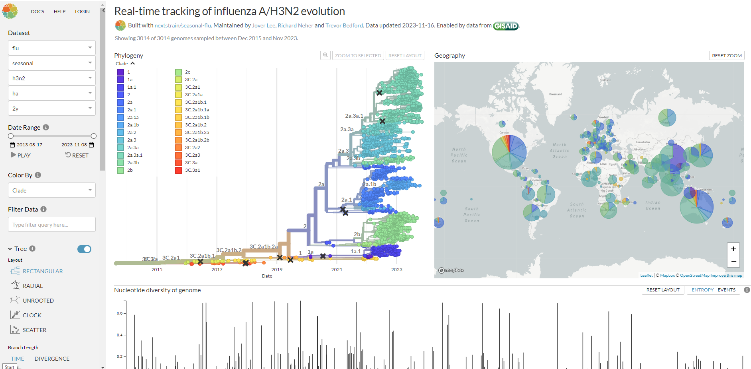

Slide 39
Time permitting - we’ll play another round, to demonstrate the effect of vaccination on ‘flu infection and evolution

Slide 40
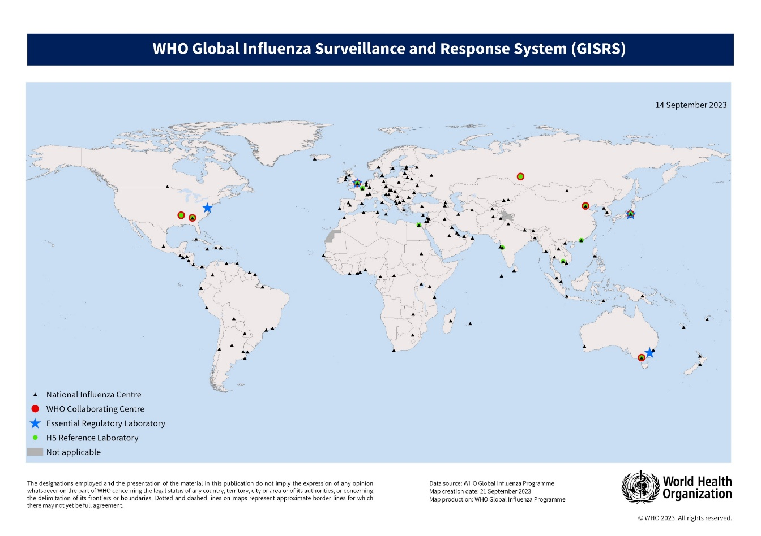
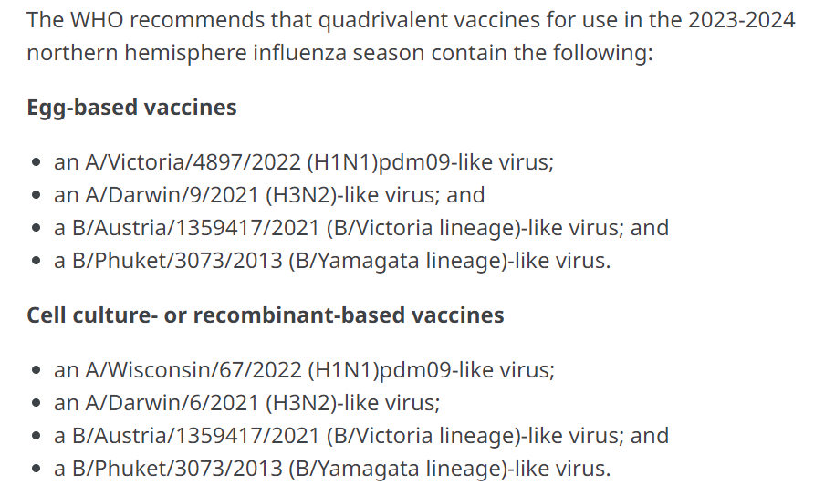
Influenza surveillance and response (WHO)
Global monitoring identifies major circulating strains
WHO panel meets to appraise evidence and recommendations from GISRS
Strains for that year’s vaccine are selected: Feb (Northern hemisphere), Sep (Southern hemisphere)
Sent to vaccine manufacturers
Vaccines prepared for use in the flu season
If a novel strain appears subsequent to this, vaccine unlikely to be protective

Slide 41
Our GISRS group must decide, based on evidence, which influenza strains to include in the vaccines for the coming ‘flu season
Choose 2 influenza A subtypes (other 2 in the quad. vaccine will be B types)

Slide 42
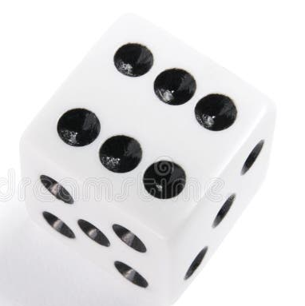
Infection Round 2
Roll 1: infection?
Roll 2: outcome?
Repeat virus evolution with new rules:
Roll a die to determine if you are infected or not.
vaccine-derived immunity: vaccine subtypes do not infect/replicate; virus types not found in the vaccine can still infect/replicate
If infected, roll again to determine the outcome of the infection. (Continue to add mutations as usual)
 | First roll of the die | Second roll of the die
1 | Pre-existing immunity | Virus replicates as normal (record genome & pass on)
2 | Infection | Co-infection! (draw another virus & reassort)
3 | Infection | Virus replicates as normal (record genome & pass on)
4 | Vaccine-derived immunity (immune IF virus type in vaccine) | Virus replicates as normal (record genome & pass on)
5 |  | Virus replicates as normal (record genome & pass on)
6 | Infection | Superspreader! (pass on to 2 people)

Slide 43
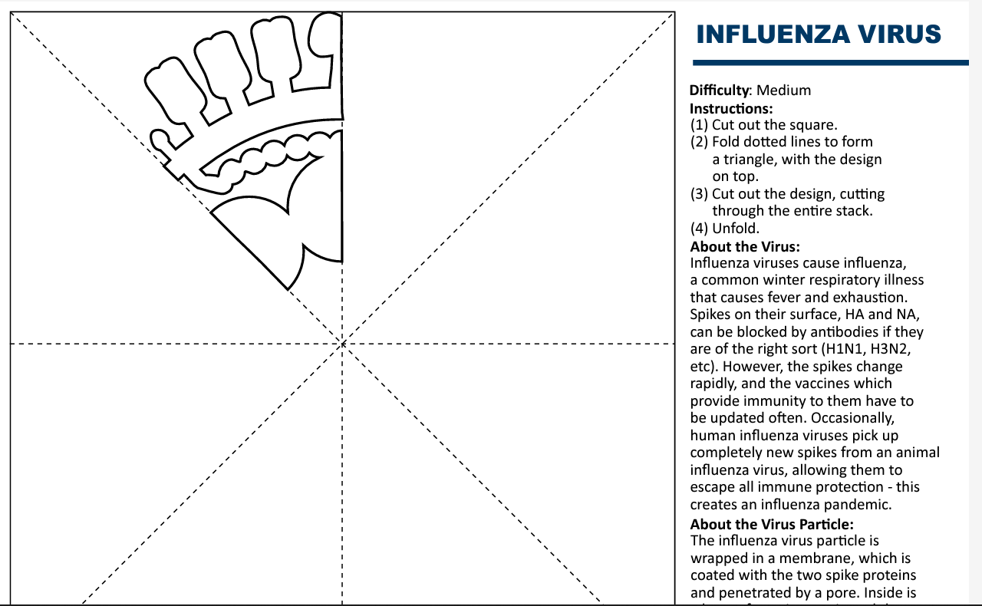
Further reading
Petrova VN, Russell CA. The evolution of seasonal influenza viruses. Nat Rev Microbiol. 2018;16(1):47-60. doi:10.1038/nrmicro.2017.118
Han AX, de Jong SPJ, Russell CA. Co-evolution of immunity and seasonal influenza viruses. Nat Rev Microbiol. 2023;21(12):805-817. doi:10.1038/s41579-023-00945-8
Chen KY, Karuppusamy J, O'Neill MB, et al. High-throughput droplet-based analysis of influenza A virus genetic reassortment by single-virus RNA sequencing. Proc Natl Acad Sci U S A. 2023;120(6):e2211098120. doi:10.1073/pnas.2211098120
Xie R, Edwards KM, Wille M, et al. The episodic resurgence of highly pathogenic avian influenza H5 virus. Nature. 2023;622(7984):810-817. doi:10.1038/s41586-023-06631-2
Dzau V, Yadav P. The influenza imperative: we must prepare now for seasonal and pandemic influenza. Lancet Microbe. 2023;4(4):e203-e205. doi:10.1016/S2666-5247(23)00013-7
FluNet: https://www.who.int/tools/flunet
NextStrain: https://nextstrain.org/flu/seasonal/h3n2/ha/2y
Make your own influenza virus snowflake →
https://cvr-engagement.co.uk/virus-snowflakes

